Slide 1
SHALE GAS IN INDIA:
Opportunities And Challenges
Team Members:
Submitted To:
Dr Pankaj Tiwari
Associate Professor
Department Of Chemical
Engineering
Abasha Sayeed(204104621)
Adnan Ahmad (170104008)
Deepak Kumar Mandal (170122014)
Mayank Sinha

Slide 2
Contents
What is Shale Gas?
How Shale is formed?
Formation of Shale Gas
Presence of Shale Gas Worldwide
Indian Shale Gas Scenario
Indian Gas Demand Scenario
Indian Gas supply Scenario
Techniques for Shale Gas Extraction
Steps for extraction of shale gas through FRACKING
Challenges associated with Shale Gas extraction
Problems associated in shale gas extraction
Supporting Evidence
Applications
Conclusion

Slide 3
What is Shale Gas?
Shale gas is a natural gas that is found trapped within shale formations. Shale gas has become an increasingly important source of natural gas in the United States since the start of this century, and interest has spread to potential gas shales in the rest of the world.
In 2000 shale gas provided only 1% of U.S. natural gas production; by 2010 it was over 20% and the U.S. government's Energy Information Administration predicts that by 2035, 46% of the United States' natural gas supply will come from shale gas.
It is a normal natural gas that never “escaped” from source rock.
It is trapped in nanometre sized pores present in brittle rock.
It is called “unconventional” because of the way the gas is trapped.
It needs to be fractured to get released.
It has large global availability.

Slide 4
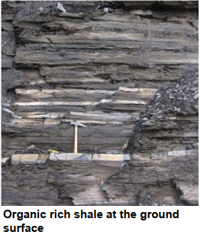
How is Shale formed?
Shale is formed from muddy sediments deposited in
seas millions of years ago.
As these sediments were buried, they were heated and
turned into rock and the organic matter was converted
into oil or gas.
These rocks are often the source rocks for conventional
oil and gas fields but have low permeability so it is
difficult to extract oil or gas from them directly.

Slide 5
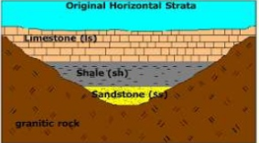
Formation of Shale Gas
Shale is sandwiched between two thick, black fine-grained shale deposits
•Continued pressure from burial forces most of the natural gas to migrate from the organic shales into sandstone and limestone forming conventional reservoirs.
•The natural gas remaining in the shales is termed shale gas.
Figure 4: Shale Gas formation.

Slide 6
Natural gas in shales has, essentially, formed from the remains of plants, animals, and microorganisms that lived millions of years ago.
Though there are different theories on the origins of fossil fuels, the most widely accepted is that they are formed when organic matter (such as the remains of a plant or animal) is buried, compressed and heated in the earth’s crust for long time.
In the case of natural gas, this is referred to as thermogenic methane generation.

Slide 7
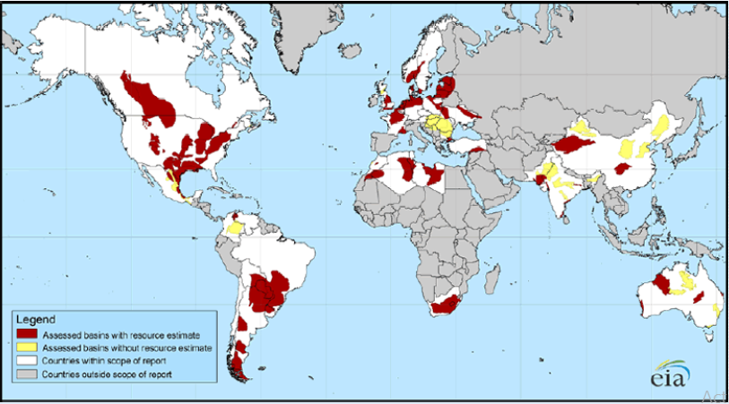
Presence of Shale Gas Worldwide
Figure 1: Shale Gas availability all over the world.

Slide 8
Although the shale gas potential of many nations is being studied, as of 2013, only the US, Canada, and China produce shale gas in commercial quantities, and only the US and Canada have significant shale gas production.
China has ambitious plans to dramatically increase its shale gas production, these efforts have been checked by inadequate access to technology, water, and land.
North America is currently the most profitable shale gas producer in the world.
•Shale gas is expected to be developed in areas of Europe and Asia because a number of significant shales are found in Europe and Asia.

Slide 9
INDIAN SHALE GAS SCENARIO
India, the world’s fourth-largest consumer of energy, could be sitting on as much as 96 trillion cubic feet (tcf ) of recoverable shale gas reserves, equivalent to about 26 years of the country’s gas demand, according to the US Energy Information Administration.

Slide 10
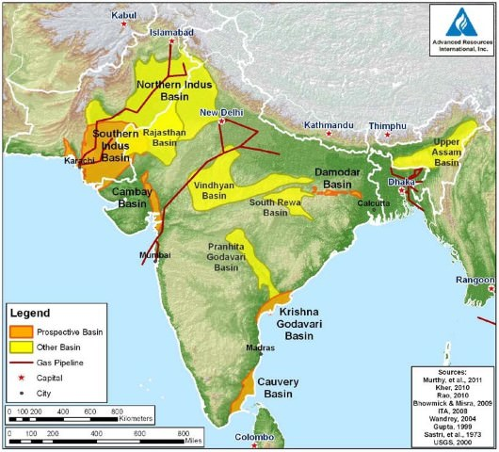
Shale Gas availability in India
Six basins -
Cambay (in Gujarat),
Assam-Arakan (in the North-East),
Gondawana (in central India),
KG onshore (in Andhra Pradesh),
Cauvery onshore and
Indo-Gangetic basins

Slide 11
CURRENT SITUATION-:
Along with the Cambay basin, the Damodar Valley Basin is a priority basin for shale gas exploration by the Government of India.
ONGC drilled two wells each in Raniganj and Karnpura basins. Out of the two wells drilled in Raniganj, one well RNSG-1 flowed gas to the surface on testing has given a way forward to the shale gas exploration in Indian basins

Slide 12
Policy On Shale Gas in India
New Exploration Li-censing Policy of 1999. This policy will allow national oil companies (NOCs) to carry out exploration and exploitation of unconventional hydrocarbon resources particularly shale gas and oil in their already awarded on land Petroleum Exploration License/Petroleum Mining Lease (PEL/PML).
Company will be permitted three assessment phases of a maximum period of three years each. In the Second phase, the government may formulate the policy for Competitive Bidding for shale oil and shale gas blocks to other companies.

Slide 13
Recent Development
ONGC had drilled the first well in Jambusar in the last week of October 2013 to explore and exploit the natural gas trapped within the shale formations located in Cambay basin, which is estimated to have a shale gas potential of 20TCF (trillion cubic feet) .
ONGC has been spending Rs 2,000 crore per annum on the exploration of oil and gas in Gujarat and Rajasthan

Slide 14
Indian gas demand scenario
India is the 3th largest energy consumer at present (Oct, 2020) and approx. 12 % share in global energy demand.
India is 4th largest LNG importer, with 42.5 MMTPA of LNG capacity.
The world natural gas consumption growth rate in the last decade was over 2.76 %, while in the Asia Pacific region it was 6.92 % and for India 9 %. This clearly indicates that the growth rate of primary energy consumption as well as natural gas consumption in India is higher compared to the world and Asia pacific average.
Any country, if its economy is in healthy growth path, this would increase consumption in the country. This increase in consumption is expected to be supplemented by an alteration in the primary energy mix of India on account of the substitution of oil by natural gas.
In recent years, The demand for natural gas has increased significantly due to its higher availability, development of transmission and distribution infrastructure, the saving from the usage of natural gas in place of alternate fuels, the environment friendly, characteristics of natural gas as a fuel and the overall favorable economics of supplying gas at reasonable prices to end consumers.

Slide 15
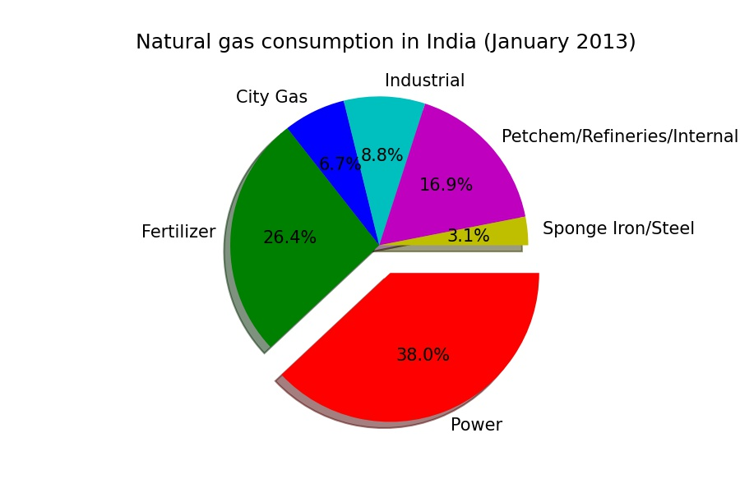
Continue...
Power and Fertilizer sector remain the two biggest contributors to natural gas demand in India and continue to account for more than 55 % of gas consumption
The total consumption of natural gas was 226.7 MMSCMD (Jan 2013) with power and fertilizer sectors consuming 86.17 and 59.86 MMSCMD of gas respectively. While Power sector consumption accounted for 38 % of the total natural gas consumption in India. The fertilizer sector consumption accounted for 26 % of the total consumption.
So, This is How the Gas Demand Scenario in India

Slide 16
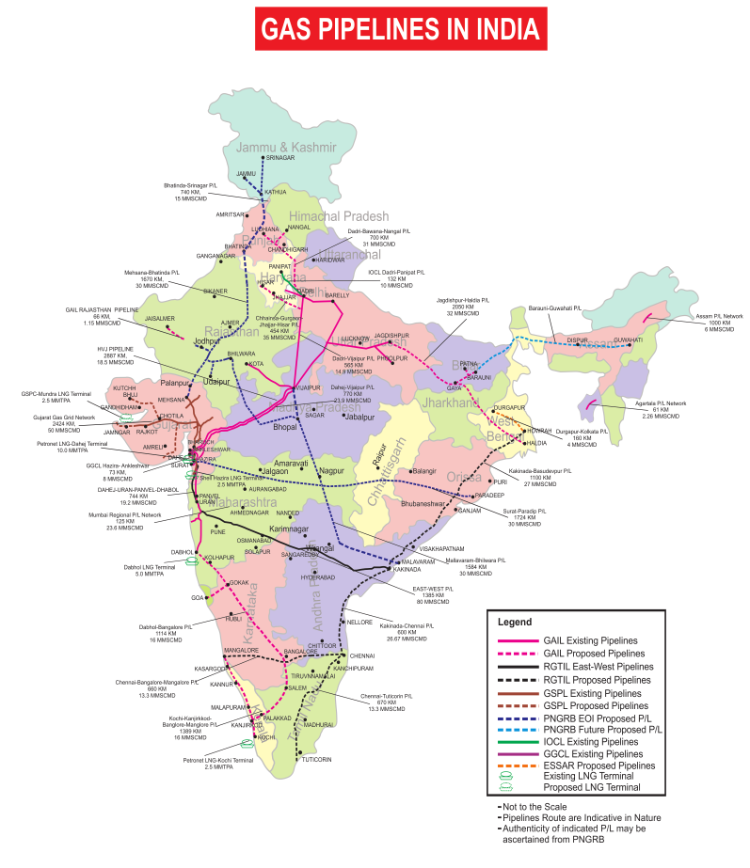
Gas supply scenario in India
The supply of natural gas is also likely to increase in future with the help of increase in domestic gas production and imported LNG.
The capacity of Degasified Liquefied Natural Gas (RLNG) terminals in India is expected to increase from 17.3 MMTPA in 2012-13 to 83 MMTPA in 2029-30 assuming all the existing and planned terminals in India would materialize.
Easy/best way to transport or supply: Gas pipeline
Solid line: Existing pipeline; West part (eg. Gujarat, Maharashtra), north India
Dot line: proposed pipeline/ in construction

Slide 17
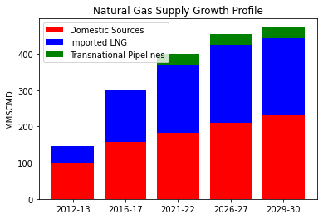
Continue...
Natural gas availability through non conventional source like Coal Bed Methane (CBM), shale gas and gas Hydrates has not been considered in gas supply projections in the absence of clarity on key variables like data as most of India remains unexplored under-explored, regulatory policy, and lack of domestic infrastructure.
The total supply of natural gas is expected to grow at a Compound annual growth rate (CAGR) of 7.1 % from 2012 to 2030 reaching 400 MMSCMD by 2021-22 and 474 MMSCMD by 2029-30.
(Data Ref. Vision 2030 by PNGRB)

Slide 18
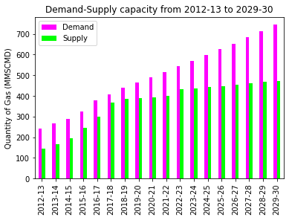
Continue...
The supply growth profile for the projected period has been provided as following.
This Capacity indicates the potential of gas transport pipeline infrastructure to meet the demand in the country.
India targets of becoming a gas based economy and increasing the share of natural gas in our energy mix from existing 6.2 % to 15 % by 2030.

Slide 19
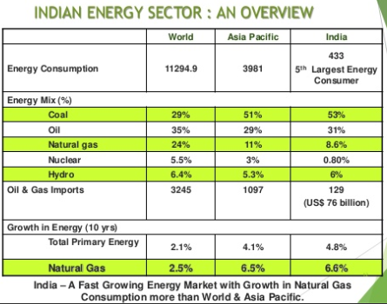
Figure 3: Overview of Indian Energy Sector.

Slide 20
India’s participation in the shale gas industry in the US
The other interesting contribution to shale gas development in the US is the export of guar gum from India, which helps in improving the viscosity and flow of water in the fracking process.
•The gum is extracted from guar ki phalli, grown mainly by farmers in arid lands in Rajasthan and Haryana.
•Its use in shale gas extraction, its production has risen enormously, earning almost US$ 5 billion during the period from April 2012 to Jan 2013.

Slide 21
Techniques for Shale Gas Extraction
Shale gas is extracted from shale rock using hydraulic
fracturing of the rock.
Hydraulic fracturing – commonly known as Fracking.
Fracking has brought substantial benefits to the nation in terms of lower energy prices, greater energy security, reduced air pollution and fewer carbon emissions (although its long-run impact on carbon emissions is less clear).
Fracking may cause many health related problems and can also lead to mini earthquakes also.

Slide 22
Steps for extraction of shale gas through Fracking
Deep holes are drilled down into the shale rock, followed by horizontal drilling to access more of the gas reserves, as shale reserves are typically distributed horizontally rather than vertically.
2. The fluid used in hydraulic fracturing commonly consists of water, proppant and chemical additives that open and enlarge fractures within the rock formation. Each company uses a different mixture of chemicals and works to protect its secret formula.
3. The chemically induced fractures can extend several hundred feet away from the wellbore. The proppants, which consist of sand, and ceramic pellets or other small particles, fill the cracks caused by the liquid and keep the newly created fractures open.

Slide 23
4. Once the injection process is completed, the internal pressure of the rock formation causes fluid to return to the surface. This fluid can contain injected chemicals as well as natural materials such as brines, metals, radionuclides and hydrocarbons.
5. Wells are drilled vertically and can extend to hundreds and thousands of feet below the land surface. The drilling may also include horizontal or directional sections, extending thousands of feet on their own, to maximise the amount of natural gas and oil collected.

Slide 24
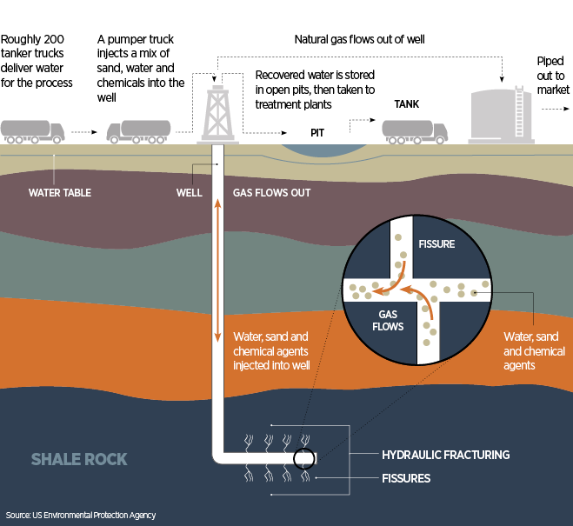
Figure 5. Process of Fracking

Slide 25
Challenges associated with Shale Gas extraction
Although shale gas is one of the fastest growing trends in onshore oil and gas exploration there is still a long way to go!
Better, more efficient technology needs to be obtained.
Natural gas historically has only provided 22% of the total energy consumed.
Each gas shale basins is different and each has a unique set operational challenges.
Because of these differences, the development of shale gas resources in each of these areas faces potentially unique opportunities and challenges.
One challenge facing Indian shale gas development is lack of relevant data in different basins of India.
Govt Policies and its Implications.
Screening Shale gas exploration targets.
Predicting production rates.
Predicting decline rates

Slide 26
Problems associated in shale gas extraction
• Groundwater issues
• Wildlife Impacts
• Community Impacts
• Surface Disturbances

Slide 27
Ground Water Issues
• Chemicals are added to water to aide in fracturing the rock
– These chemicals goes to the amount of ground water causing water pollution
– In using this technique researchers are trying to find a way to cut down on water pollution
• It takes 2 million to 4 million gallons of water to drill and fracture a horizontal shale gas well
– In the long run is not to bad compared to agricultural and municipal use.
– Only 1% - 8% of total water use

Slide 28
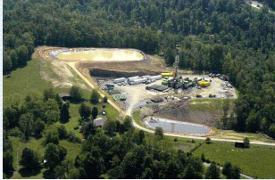
Wildlife Impacts
Gas development can adversely
affect animal habitat and wildlife.
They can drill underneath areas
Like wetlands to reduce wildlife
disturbances.

Slide 29
Community Impacts
• There are certain Community issues that can arise
– Damage to roads
– Traffic congestion
– Noise
– Dust
• It takes intense planning to ensure that these factors have the smallest impact possible

Slide 30
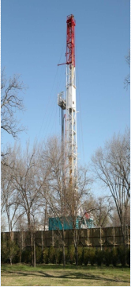
Surface Disturbances
Vertical wells can require up to 40 acres per well or 16 wells per square mile whereas Horizontal wells take up much less space and are more efficient.

Slide 31
Supporting Evidence
It has large global availability.
Shale rocks not only contain shale gas but they also contain petroleum and natural gas in certain amount which further leads to increase in overall production of natural fuel.
It is cleaner than other fossil fuels as it leads to lesser carbon emissions.
It is an economic source of energy.
It has low maintenance costs.
It is environment friendly.

Slide 32
Applications
Power generation
Residential application
Industrial and manufacturing applications
Commercial Applications
Transportation

Slide 33
Conclusion
As we are running out of sources of natural fuel, we can see shale gas as an efficient source of fuel for the present as well as the future generations.
As of now, researches are going on in India to find out more shale gas reserves.
Unconventional reservoirs are required to be evaluated by collection of more data by initiating Pilot Projects in Shale Gas as earliest as possible
More work is undergoing in the field of shale gas in order to develop more efficient and low cost techniques for the extraction of shale gas.
It is an economic way of increasing gas production in India.
If shale gas production is increased in India, India’s dependence for fuel over other countries can be eliminated and hence can strengthen the Indian economy.
There is a need to undertake more extensive exploration and appraisal activities to better assess the commercial viability of shale gas.

Slide 34
REFERENCE
[1]Ravinder Arketi, Bijaya K Behera, Uttam Kumar Bhui “Shale Gas In India :Opportunity And Challenges”volume:4,issue:3 march 2015
[2] V.A. kuuskraa, S.H.Stevens and K.Moodhe EIA/ARI World Shale Gas And Shale Oil Resource Assesment 2013 P XXIV –I
[4] http://www.business-standard.com/india/news/ongc-finds-maiden-shale-gas- reserves-in-india/123723/on
[5] http://www.scientificamerican.com/article.cfm?id=shale-gas-and-hydraulic-fracturing

Slide 35
THANK YOU!!

